Slide 1
Adding Column Feature and Price Prediction
Shlok Misra

Slide 2
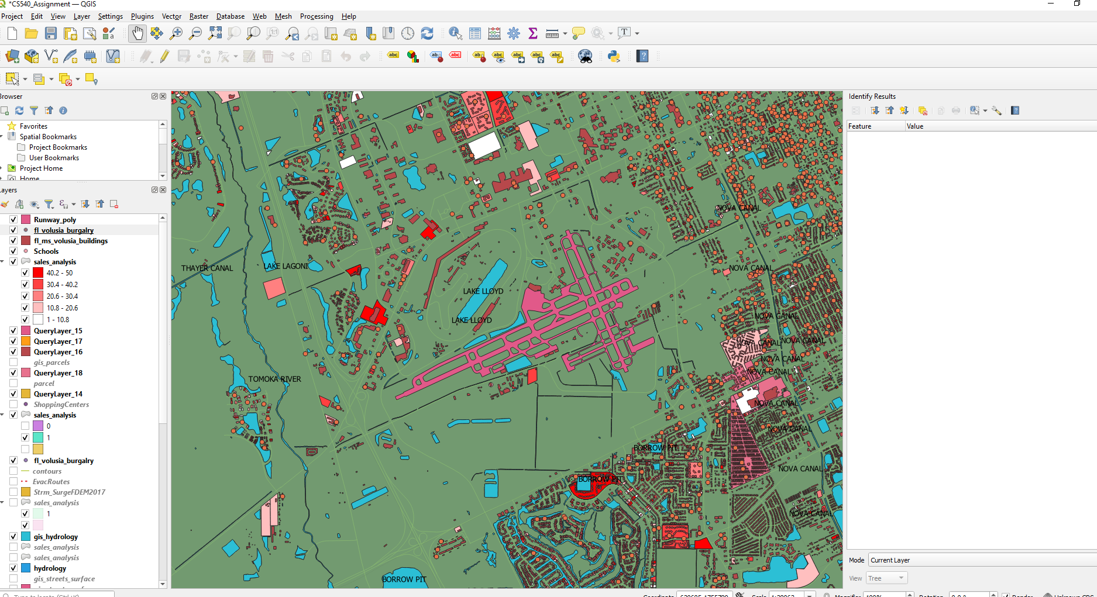
I will be finding distances from any runway. My hypothesis is that there is a relationship between distance of a home from the runway and the price of a house.
I have loaded the runway polygon from Volusia.org/gis.

Slide 3
Note
I have only loaded the runway at Daytona Beach Airport on QGIS. However, the properties on my pgadmin or my analysis will include distances from all runways in my area such as Daytona beach, Ormond Beach, New Smyrna and Edgewater/Massey.

Slide 4
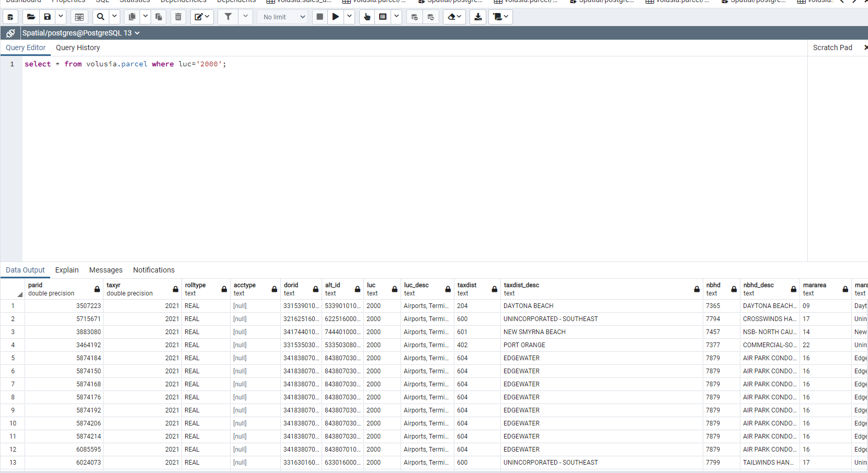
Retrieving Properties

Slide 5
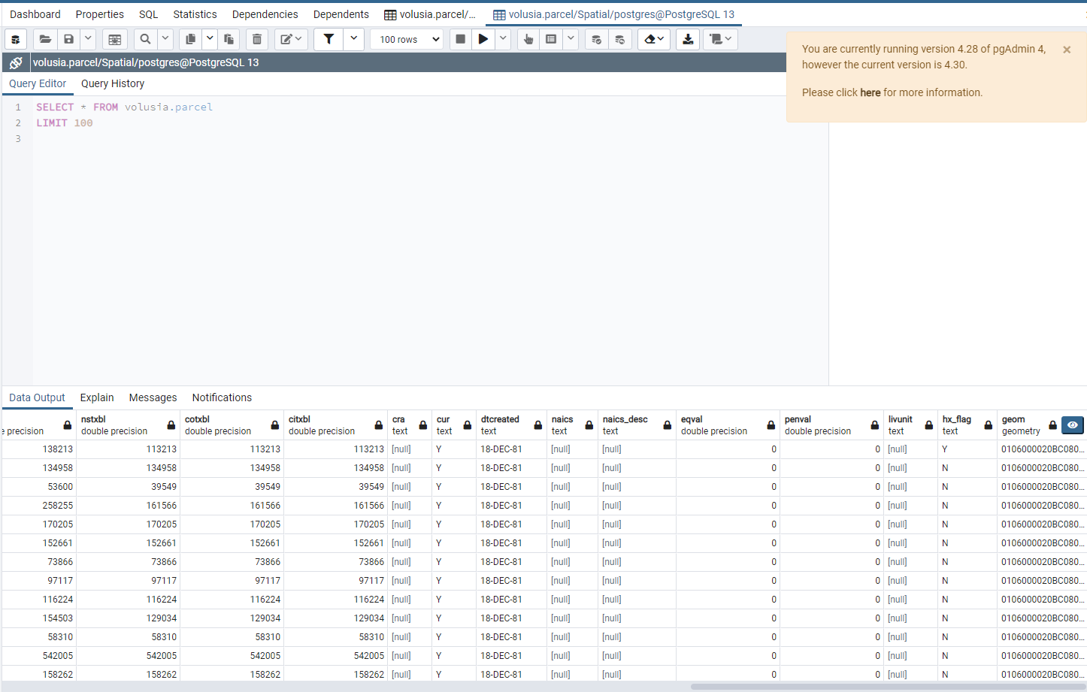
The GEOM column was added

Slide 6
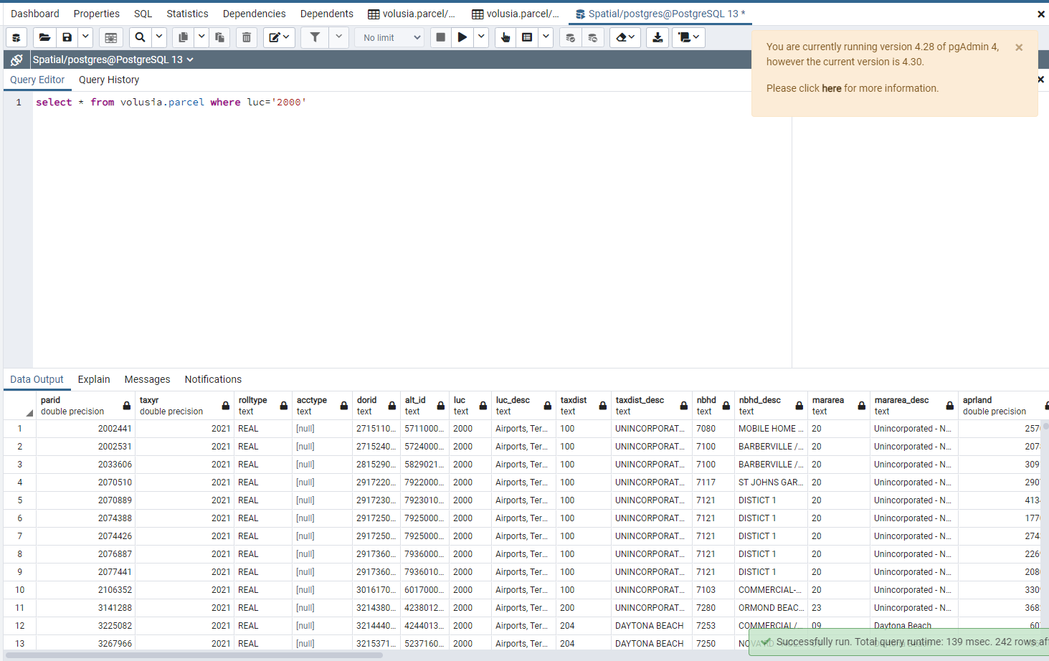
We now want Distance between every parcel and the nearest runway. These are all the airport parcels in the parcel table

Slide 7
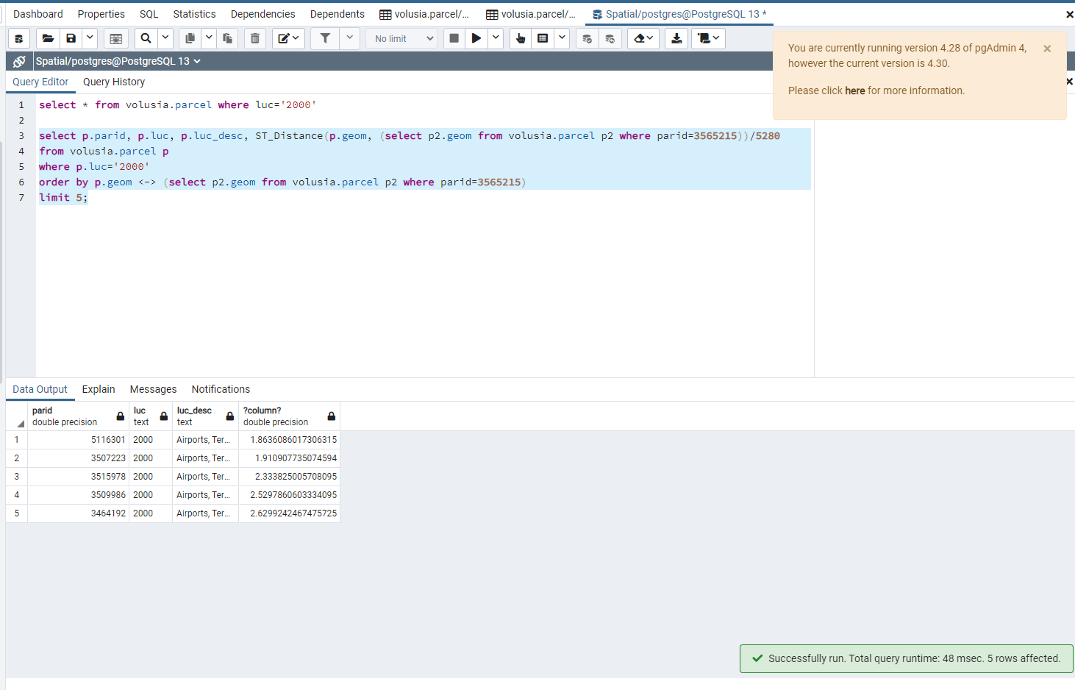
These are the 5 closest airports to the parcel=3565215

Slide 8
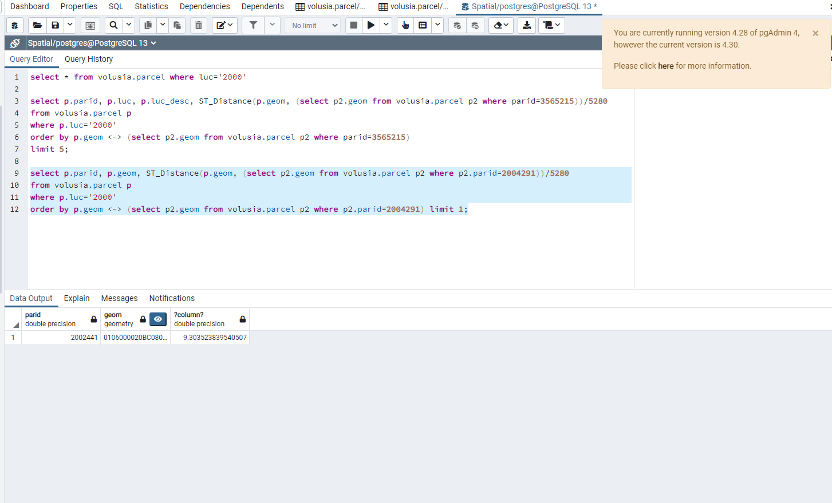
Similar code, but now I find the closest airport to a parcel. We can see that the closest airport from the parcel (2004291) is parcel 2002441

Slide 9
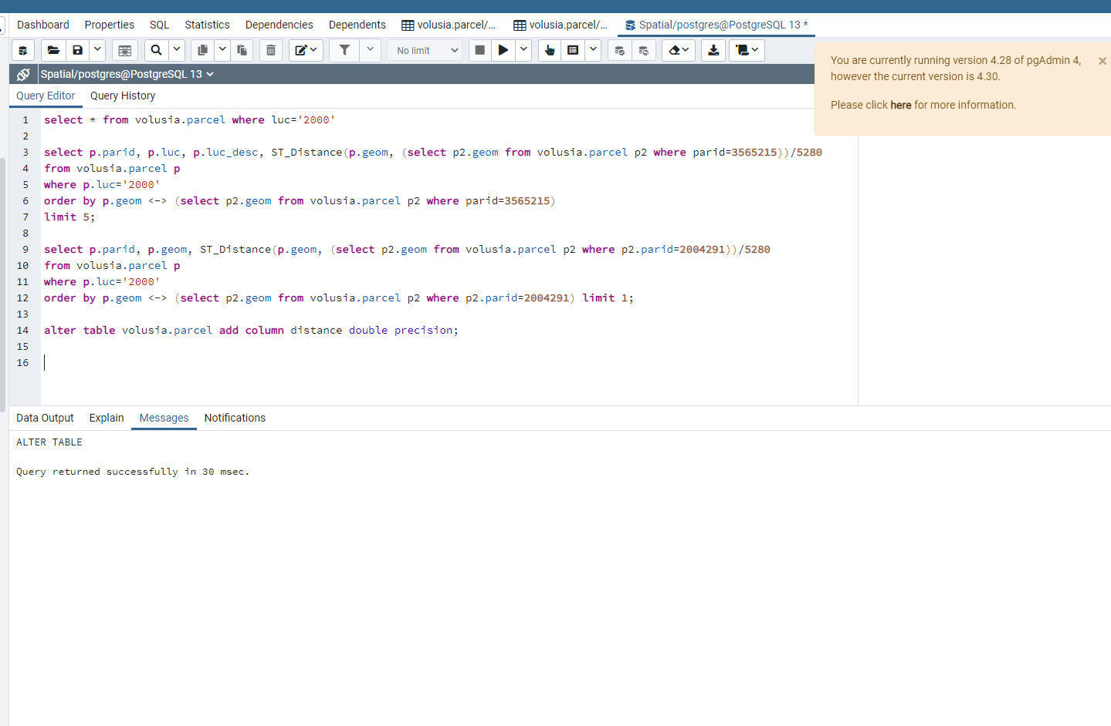
Adding a Distance column

Slide 10
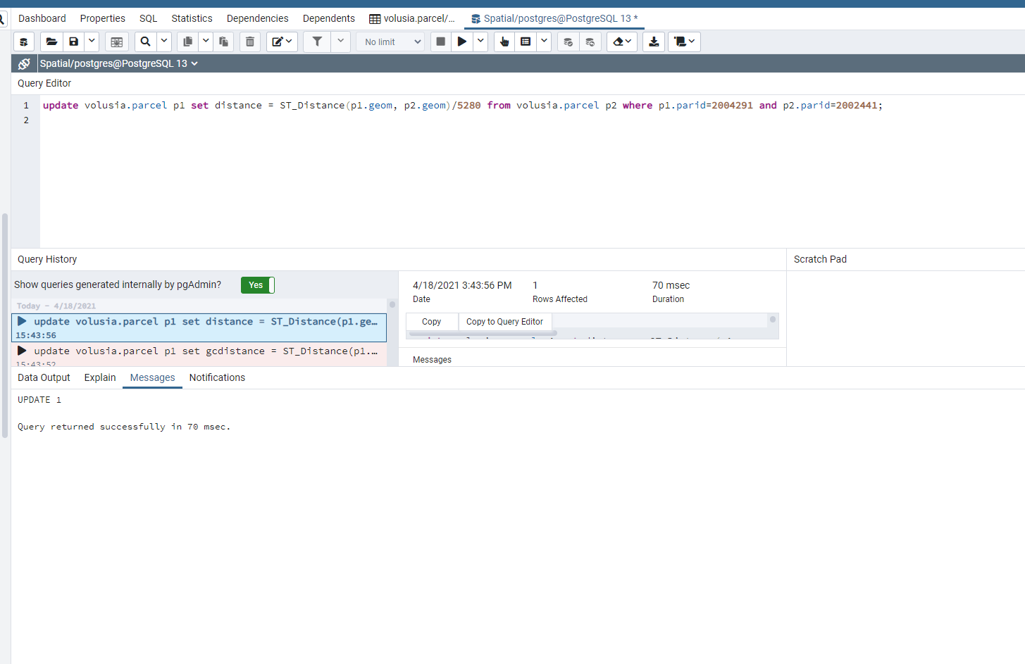
We find the distance between our parcel (2004291) and the airport (2002441)

Slide 11
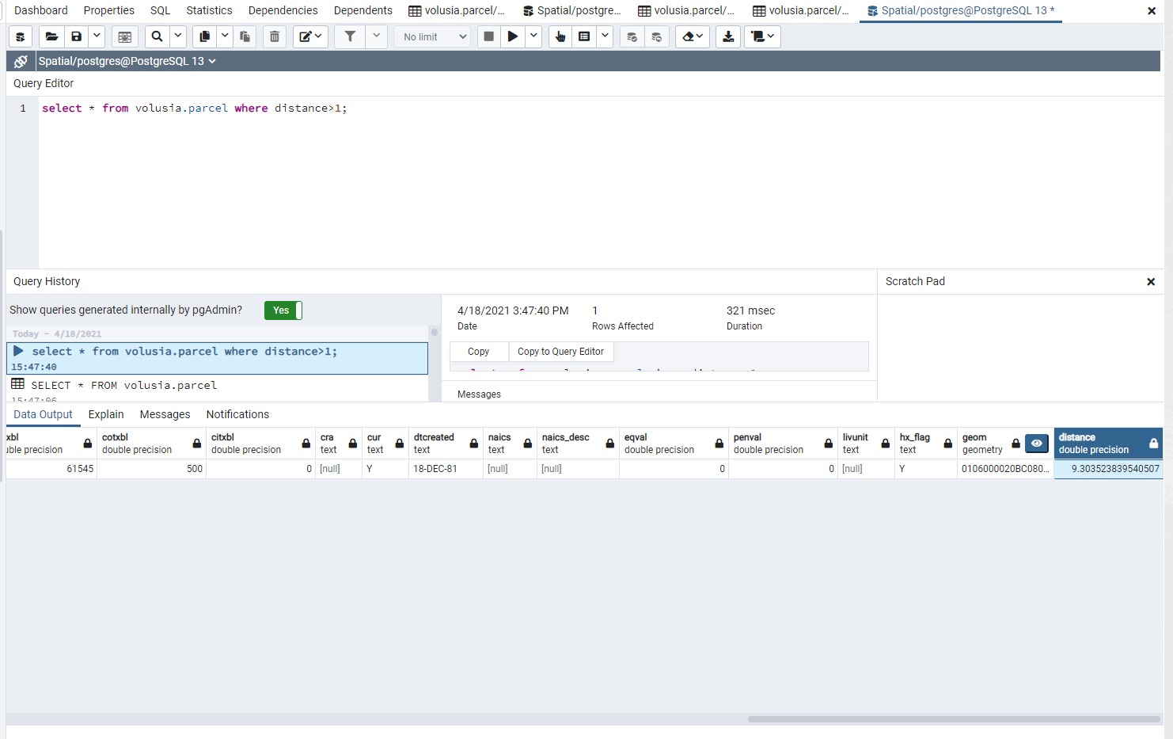
Distance=9.30352

Slide 12
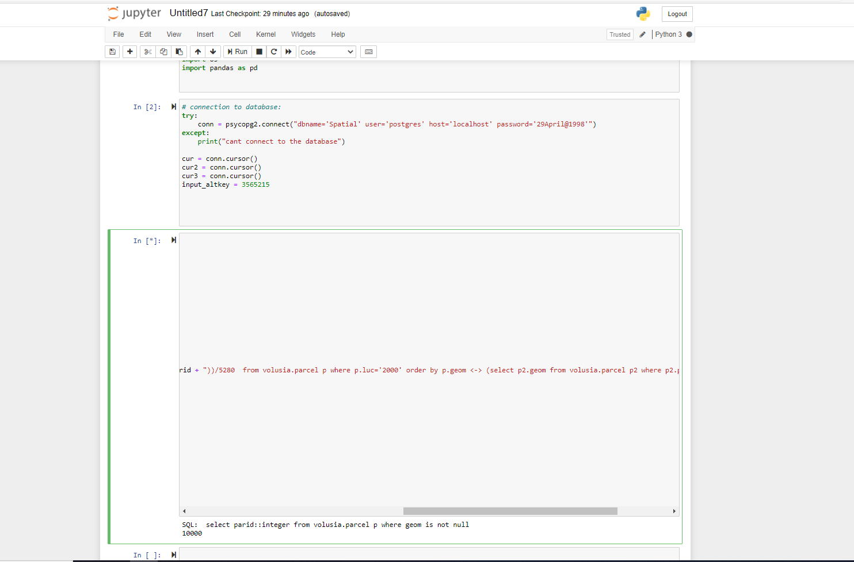
I ran the code for the loop.

Slide 13
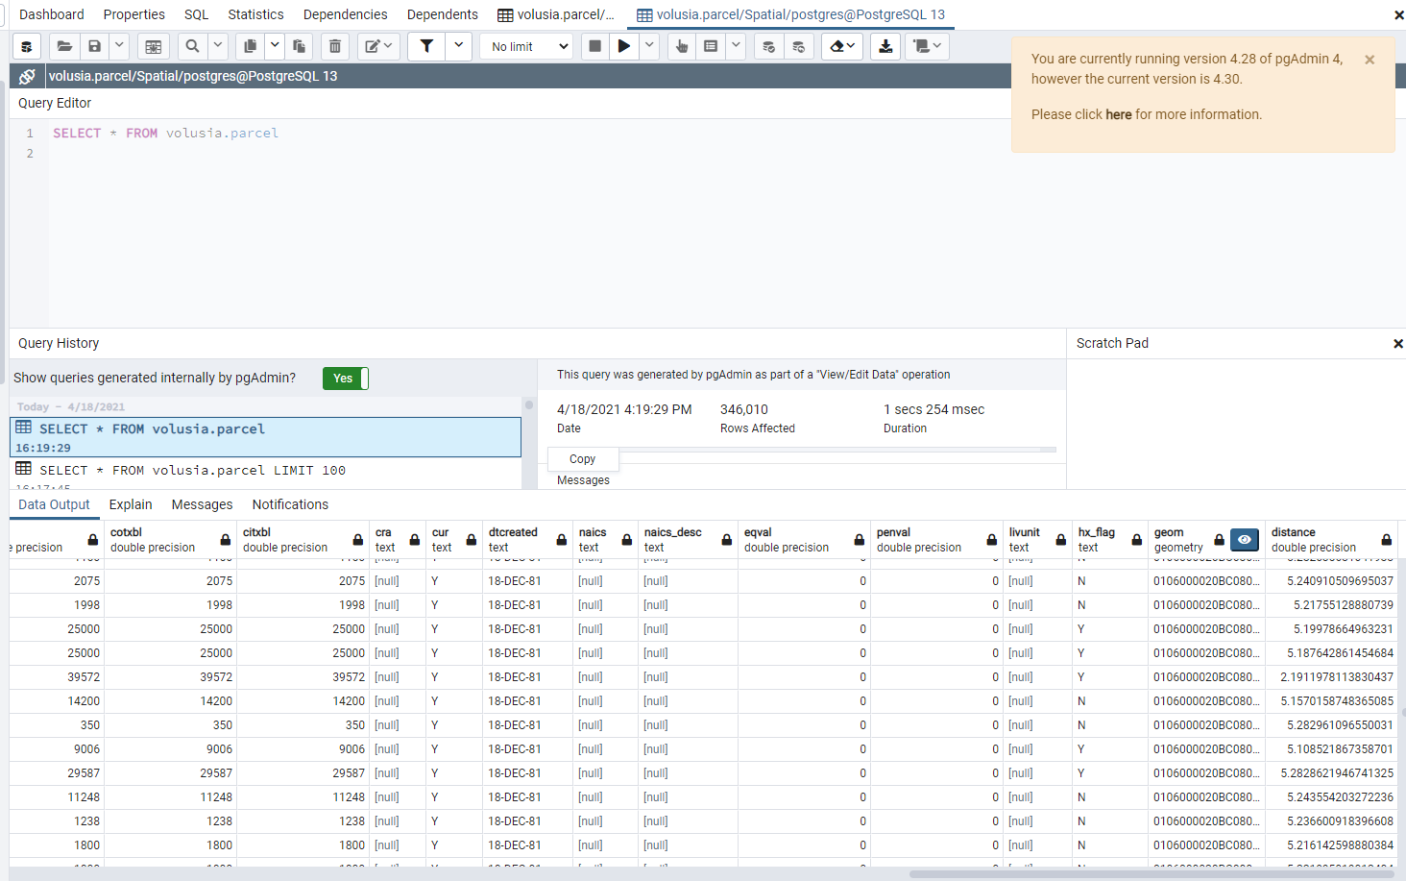
We have the distances from every parcel to the closest airport.

Slide 14
Now I will add flight tracking information
The Daytona Beach area has a lot of flight activity, but we are only interested in commercial jets as they are the aircraft that produce the most noise.
New Symrna, Deland, Ormond, and Massey do not have commercial flights. We will only analyze flights from Daytona.
Also, I was only able to retrieve flight data for Daytona Beach for free.
Daytona Beach uses take-offs from two runways for most purposes. Runway 7L and Runway 25R. Both commercial services (American and Delta) take off to the north (Charlotte and Atlanta). So I retrieved two historical flights tracks for Delta 1701. One took off from Runway 7L and one from Runway 25R.

Slide 15
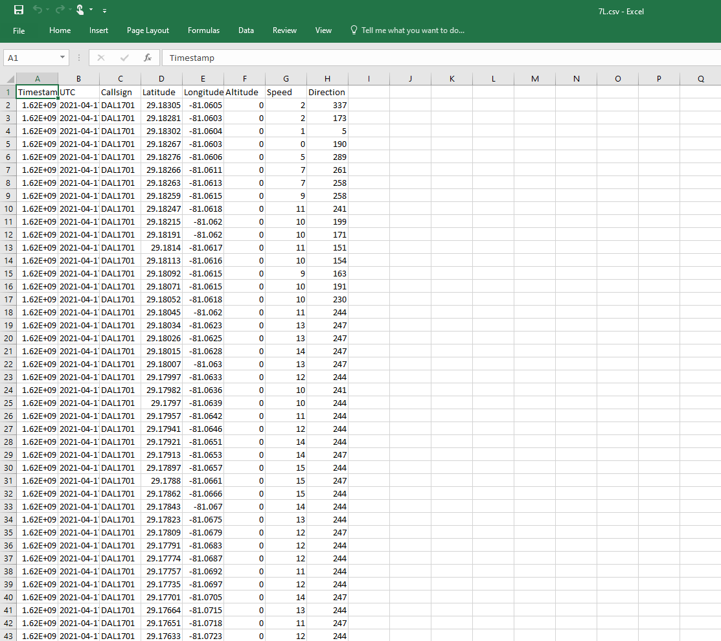
The data was available in CSV format.

Slide 16
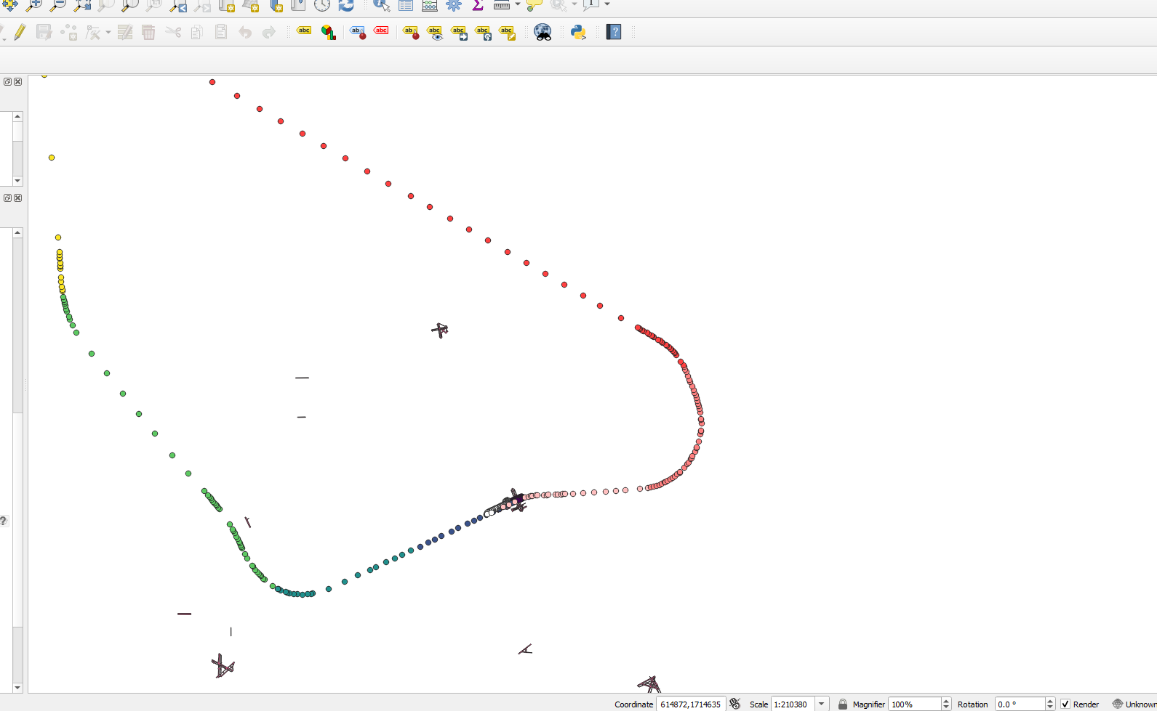
I wanted to visualize this on QGIS. So I added the two files as Delimited Text Layers

Slide 17
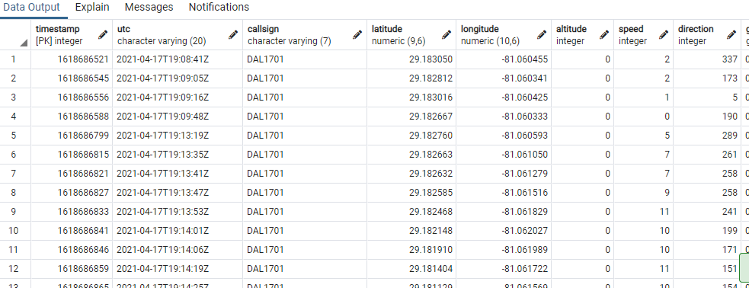
I also created two tables on Postgres for distance calculations. I used an online csv→ sql converter to generate the SQL tables.

Slide 18
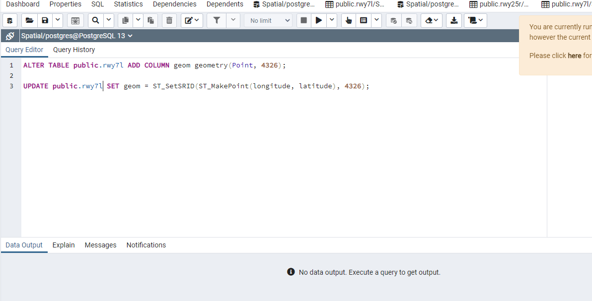
To create the Geometry Table, I used the following codes

Slide 19
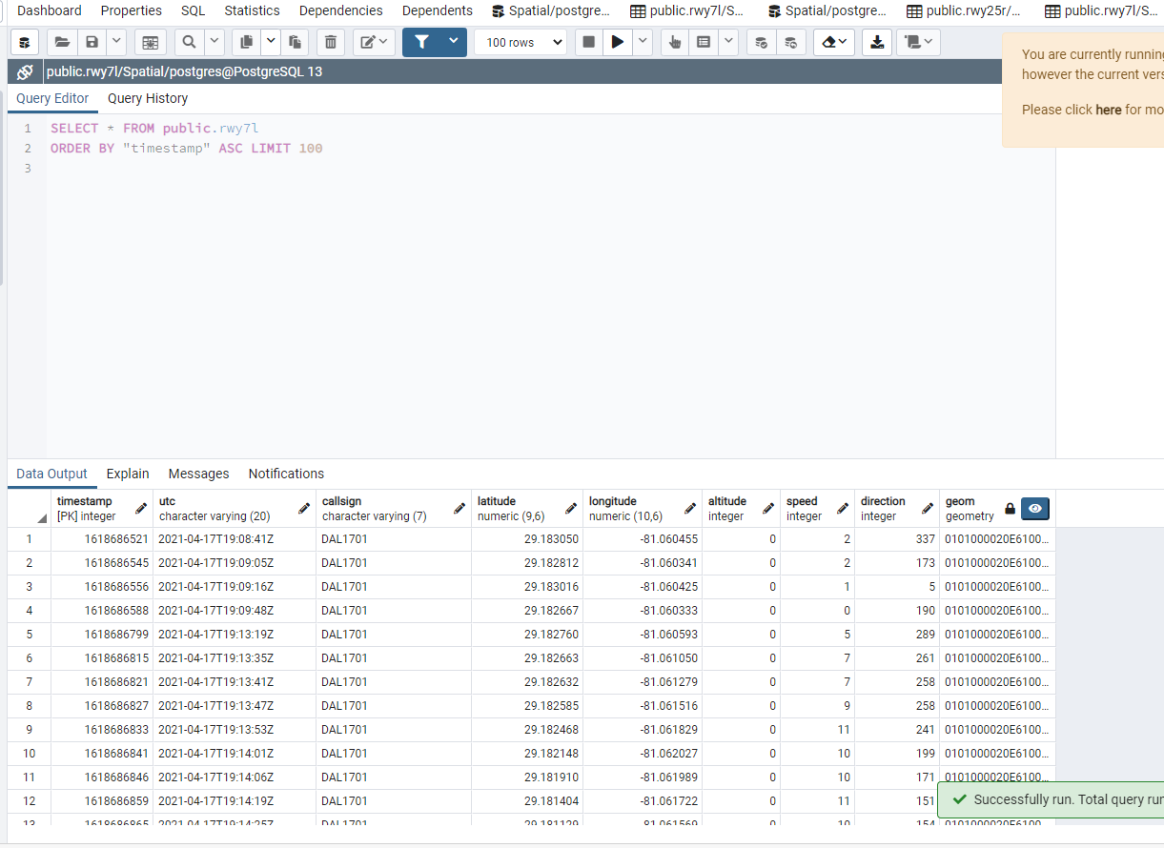
I have a geom column now. Now I need to assign the flight tracks a common luc for distance calculations

Slide 20
I will now try to find the distance of each parcel in the parcel table to the flight track.
I will use the same code I used for the runway. The runways had a luc of 2000. I have assigned an LUC of 0001 to the flights tracks.

Slide 21
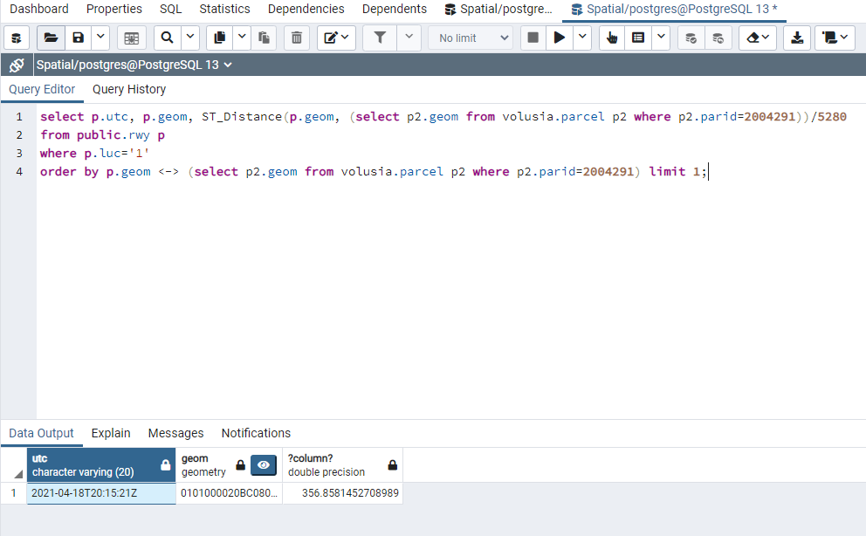
Finding the closest flight tracking point to a random parcel.
I have used UTC as an identifier
for the flight track information.

Slide 22
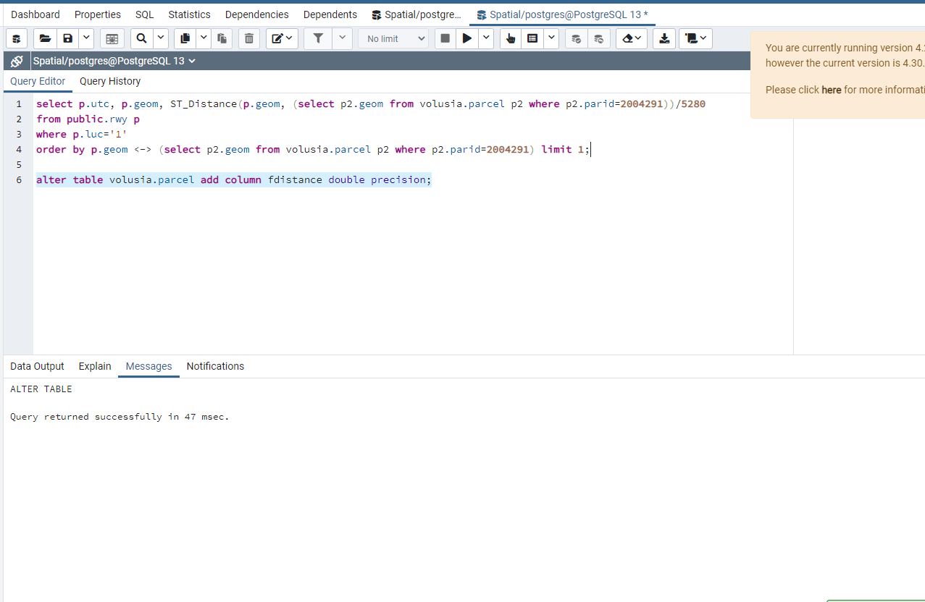
Add column for distance from Flight Track

Slide 23
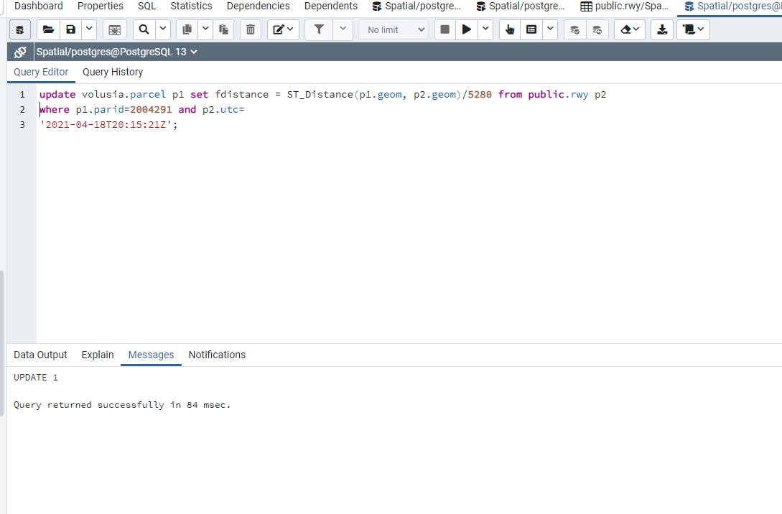
Find Distance Between parcel and Flight Track

Slide 24
I will now move on to the python code and adjust it accordingly to populate the remaining values of fdistance

Slide 25
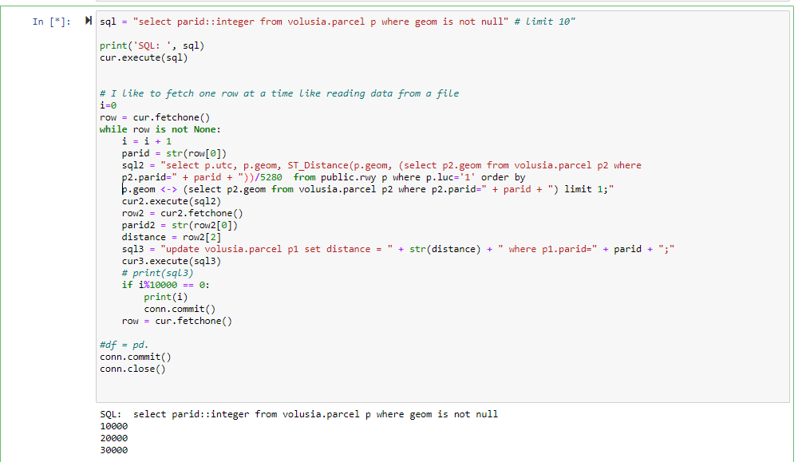

Slide 26
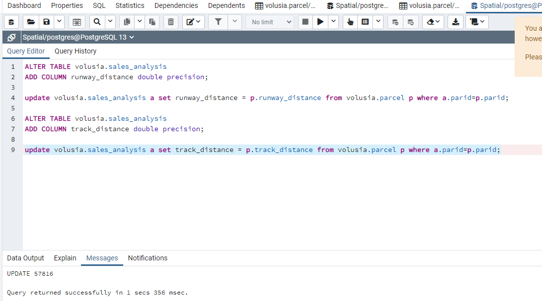
Add runway_distance and track_distance to the sales analysis table.

